Slide 1

Enhancing Human-Computer Interaction with Hand Mapping.
(Google AI Edge)
Team Members:
Harish Gowtham B–(23uad053)
Venkatesh M-(23uad054)
Rajesh B-(23uad058)
Guided By,
Mrs.K.Muthulakshmi/ADS

Slide 2
CONTENTS
Literature Review & Gap Identification
Problem Definition & Objectives
Technical Design / Process Flow
Prototype Readiness
Innovation & Patent Potential
Business Model & Market Viability
SDG Goals & Societal Impact
Scalability & Product Conversion Feasibility
Ability to Respond to Queries & Communication

Slide 3
Problem Statement
Traditional presentations are usually controlled using a keyboard, mouse, or remote. These devices need physical touch and can limit the presenter’s movement. Sometimes these devices may stop working or get lost. In today’s world, touchless technology is becoming important. Using AI and computer vision, presentations can be controlled using hand gestures. So, a smart hand gesture system is needed to make presentations easier and more interactive.

Slide 4
Base Paper
Gesture Master: Real-time Hand Gesture Control for Interactive Presentation Using Computer Vision
Authors: Akkireddy Pavan Kumar, Gudiwaka Vijaya Lakshmi.
Published in: International Journal of Innovative Research in Technology.
Abstract: This paper presents a presentation control system that uses hand gestures and voice commands to control PowerPoint slides. The system uses computer vision with OpenCV and the cvzone library to detect and recognize hand gestures. It allows users to navigate slides, control a virtual pointer, annotate, delete content, and zoom using simple gestures. The system improves presentation efficiency and accessibility by removing the need for traditional input devices.

Slide 5
Introduction
In recent years, Human-Computer Interaction has improved with the help of Artificial Intelligence and Computer Vision technologies.
Traditional presentation systems depend on devices like mouse, keyboard, or remote controllers which require physical interaction.
Hand gesture recognition systems allow users to interact with computers in a natural and touchless way.
Using technologies like OpenCV, MediaPipe, and AI models, real-time hand tracking and gesture detection is possible.
This system helps to make presentations more interactive, efficient, and user-friendly in classrooms, seminars, and business meetings.

Slide 6
Technology and Algorithm
MediaPipe (Google AI Edge)
OpenCV (Open Source Computer Vision Library)
Cvzone
PyAutoGUI
Convolutional Neural Networks (CNN)
Transformer Models
Finger-Earth Mover’s Distance (FEMD)

Slide 7
Objective
To develop a hand gesture-based system to control presentation slides without using physical devices.
To implement real-time hand gesture recognition using Computer Vision and AI technologies.
To improve presentation flexibility and user interaction using touchless control methods.
To create an accurate and reliable system that works under different lighting and background conditions.

Slide 8
Literature Survey
Title: Hand Gesture Controlled Presentation System
Methodology:
Uses OpenCV and MediaPipe for real-time hand tracking and gesture detection. Webcam captures hand movement and finger positions are analyzed to control slides.
Advantage:
Low cost (only webcam needed)
Real-time performance
Easy to implement
Limitation:
Performance affected by lighting conditions
Background noise may reduce accuracy

Slide 9
Requirement Specification
Hardware Requirements
Laptop or Computer
Webcam (In-built or External)
Minimum 8GB RAM
Processor: i3 or above
Software Requirements
Python Programming Language
OpenCV Library
MediaPipe Library
VS Code
Windows / Linux Operating System

Slide 10
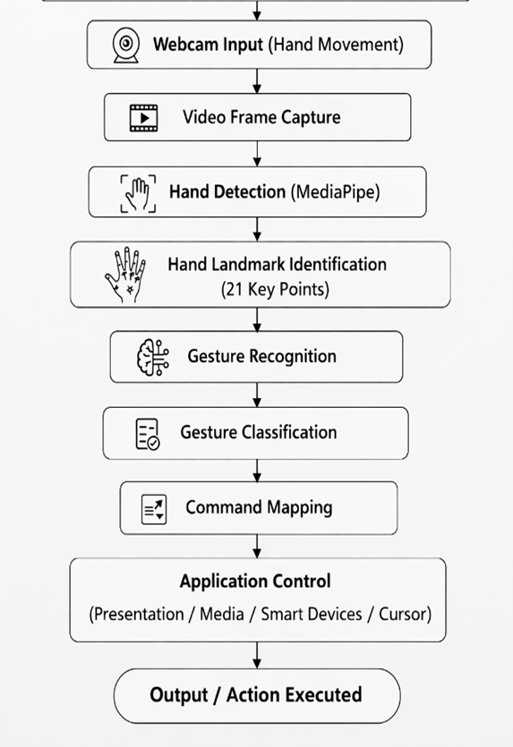
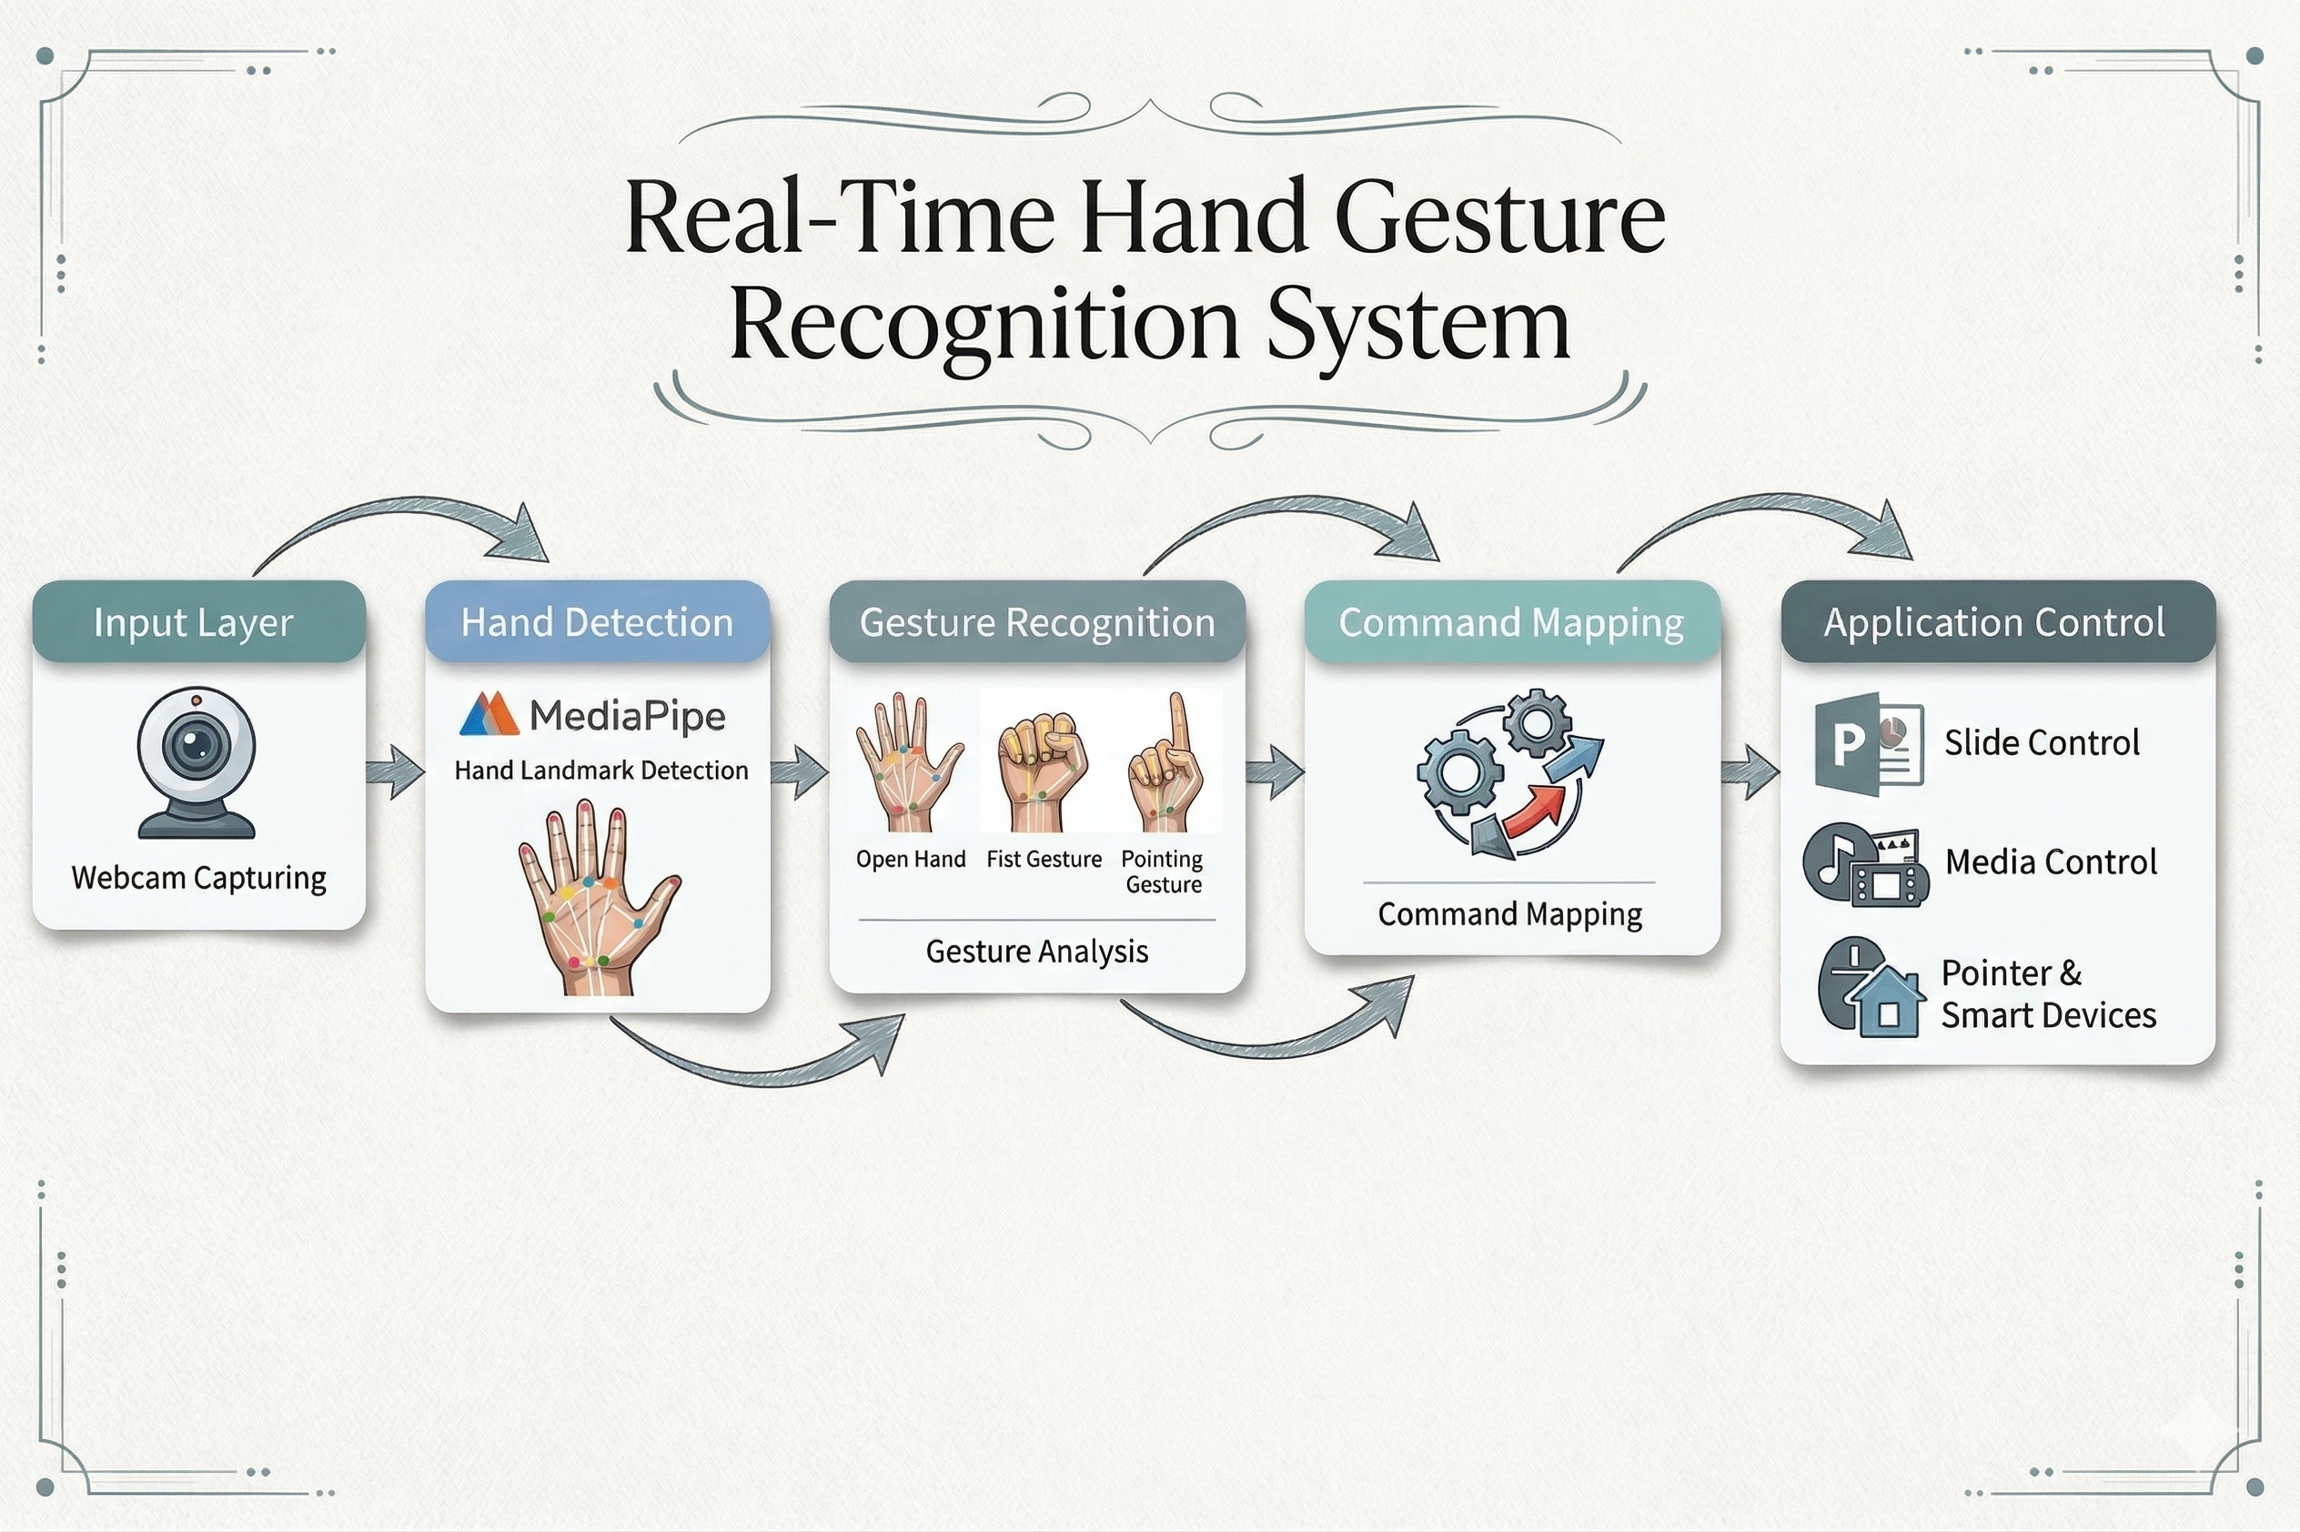
System Design

Slide 11
Module Implementation
Input Module
Hand Detection Module
Gesture Recognition Module
Control Action Module
Output Module

Slide 12
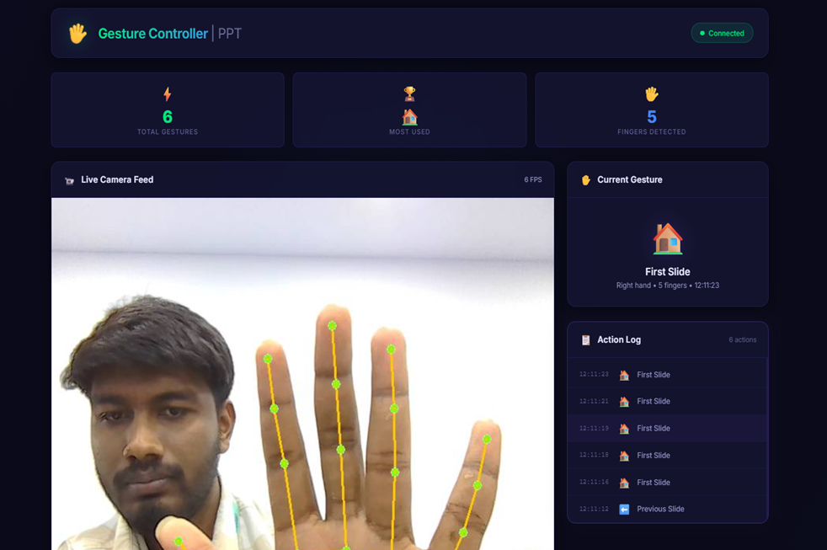
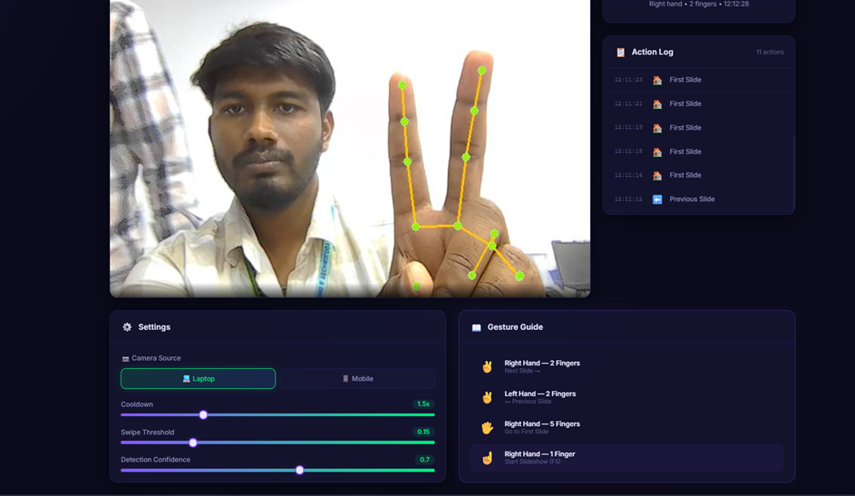
Screenshots/Results

Slide 13
Social Impact
Promotes touchless technology, improving hygiene and reducing physical
contact with shared devices.
Helps differently-abled people to control presentations easily using hand gestures.
Improves teaching and learning experience in classrooms through
interactive presentations.
Encourages use of AI and smart technologies in daily applications.
Reduces dependency on physical devices like remotes and clickers,
saving cost and resources.

Slide 14
References
https://ijirt.org/Article?manuscript=174316
https://www.ijert.org/hand-gesture-recognition-based-presentation-system
https://www.irjmets.com/upload_newfiles/irjmets70600069749/paper_file/irjmets70600069749.pdf
https://journal.admi.or.id/index.php/IJST/article/download/2244/2169/7070
https://www.semanticscholar.org/paper/Hand-Gesture-Controlled-Presentation-using-OpenCV-Sruthi-Swetha/a1371d6558e2b4d2fe08cfd363f94d62f9aa4793
https://rjpn.org/ijcspub/papers/IJCSP25A1142.pdf

Slide 15
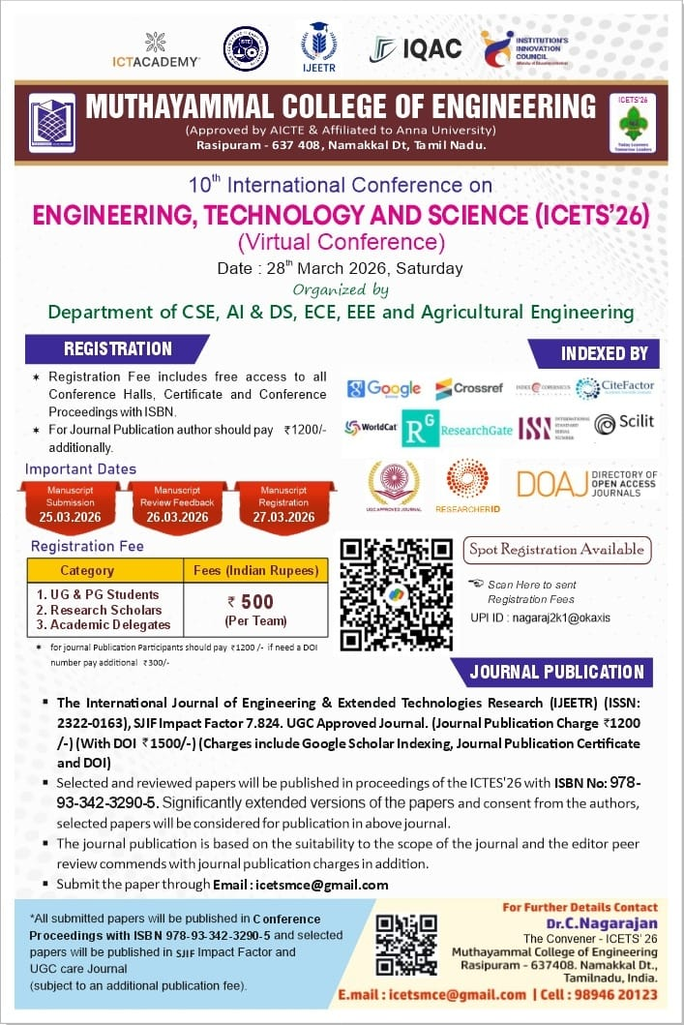
Journal/Conference Details

Slide 16
Thank You

